Slide 1


Is Foreign Influence Effecting your Business?
Foreign Owned, Controlled, or Influenced (FOCI) Defense Contractors
FISWIG Annual Conference: 11/30/2010, Rev 1

Slide 2
Agenda
DSS Statistics
FOCI
  Indicators
  Mitigation instruments
  Process – Implementing FOCI controls
  Plans – Developing a compliance program
  Operation – Putting plans into action
  Case Study
  Local Issues – FAQ’s for defense contractors

Slide 3
Acronyms
ASA – Administrative Services Agreement
BoD – Board of Directors
BR – Board Resolution
ECP – Electronic Communications Plan
EECC – Export Enforcement Coordination Center
FOCI – Foreign Owned, Controlled, or Influenced
GSC – Government Security Committee
PA – Proxy Agreement
SCA – Security Control Agreement
SSA – Special Security Agreement
TAA – Technical Assistance Agreement
TCP – Technology Control Plan
VT – Voting Trust

Slide 4
DSS Stats
NISP
  Approx 9,000+ companies, 13,000+ facilities
  Approx 1M PCL’s
IT Services
  Approx 100,000 ISFD worldwide users
Counter Intelligence
  Approx 4,200 Suspicious Contact Reports FY09
  Approx 420 Intelligence Reports FY09
Training
  Approx 65K Students FY09
  Approx 53 K Students FY08
FOCI
  252 FOCI Mitigation Agreements
    26 PA (11%)
    98 SSA (42%)
    38 SCA (16%)
    73 BR (30%)
  675 Facilities (branches & subsidiaries)
  65 different countries
DSS Activities involving all Cleared Contractors
FOCI Specific Activities
Mission: “Assist with accessing the Foreign Ownership, Control, or Influence mitigation strategies presented for companies cleared under the FOCI mitigation instrument.”
4

Slide 5
Indicators of FOCI
Generally outlined on the SF-328 http://www.dss.mil/isp/foci/documents/sf328.pdf
Foreign Ownership (Ownership) (1-302g5, 2-310)
  Merger, acquisition, takeover
Foreign Management (Control) (2-300)
  Company Management/BoD
  Classified Contract Management (extreme CLM)
Foreign Investment (Influence) (1-302g5, ISL 2009-03)
  Stockholders
  Anyone who can influence the election, appointment or tenure of BoD
Foreign debt, agreements with governments, etc. (Influence)
Foreign National Employees/visitors
  Foreign employees of parent stationed at US company
  Foreign Nationals hired-on by US company
  Foreign subcontractors working overseas at parent
  Unlicensed Foreign Nationals working on unclassified defense projects
5

Slide 6
FOCI Mitigation Agreements
NISP Requirements:
  FOCI companies enact additional protective measures before being allowed to work on a US classified program (2-300, 2-303).
Protective measure is implemented in the form of a Mitigation Agreement.
  Depends principally on (1) extent of foreign control (2) sensitivity of the information
Type of agreement is dependant on SF-328
  Board Resolution (BR)
    Foreign Interest has minority ownership insufficient to elect board members
  Security Control Agreement (SCA)
    Foreign Interest has minority ownership sufficient to elect board members
  Special Security Agreement (SSA)
    Foreign Interest has majority ownership and effectively controls company
  Proxy Agreement (PA)
    Company has stock/loans/debt to foreign interest , but retains legal title while transferring voting rights to U.S. proxy
  Voting Trust (VT)
    Foreign interest transfers legal title to U.S. citizen trustees
Notes:
U.S. company is considered under FOCI whenever a foreign interest has the power, direct or indirect, whether or not exercised, and whether or not exercisable through ownership of the U.S. company’s securities, by contractual arrangement or other means, to direct or decide matters affecting the management or operations of that company.
“Protective measures are intended to insulate contractor facilities from undue foreign control and influence and to reduce the risk of unauthorized foreign access to classified information.” (GAO)

Slide 7
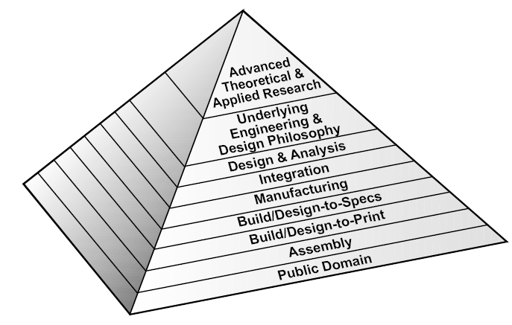
Why the U.S. Allows FOCI
DoD recognizes the technical contributions made by foreign companies, with consideration of:
  Espionage against U.S. targets
  Unauthorized technology transfer (export controls)
  Compliance with U.S. laws & regulations
  Type & nature of technology / tech data
  Source, nature, & extent of FOCI
  Bilateral/multilateral agreements w/ other nations
  Foreign government ownership or control
  Other factors indicative of influence to business operations
Advantages of Mitigation Agreement
  Ability to work on otherwise restricted programs.
  Reputation advantages
  Technology Transfer
  U.S. accounts for 40% of global arms spending
7
Notes:
FOCI is a security threat to critical U.S. infrastructure. Since 2001, direct foreign investment into certain U.S. industries has been on the rise: communications systems, Foreign Investment in the U.S. thru acquisitions, mergers, and takeovers, and entities handling classified information.
Five base areas for unclassified issues: (1) personnel screening (2) outsourcing (3) visitation (4) routing (5) network security.

Slide 8
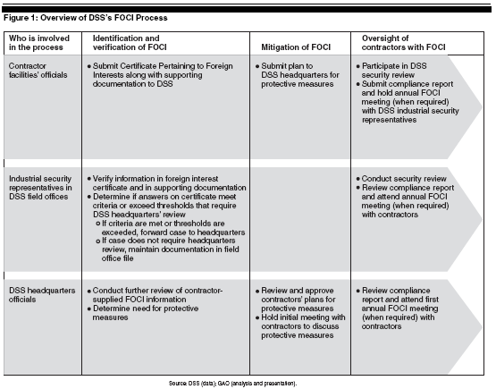

FOCI Mitigation Process
DSS follows a specific process to grant a FOCI company authority to operate on classified contracts.
E-FCL Reporting
Key process is organizing the BoD and GSC.
See the GAO Report for more information: http://www.gao.gov/new.items/d05681.pdf

Slide 9
Company FOCI Oversight
Outside Directors
(Impartial Oversight - DSS Approved)
Establish GSC Plans (TCP, ECP, SPP)
Inside Directors
No Classified info
Key Management Personnel (Secretary, FSO, TCO/ECO, etc.)
Cleared/Uncleared
Government Security Committee
Ensure implementation & monitoring of SSA
DSS Reporting
Executes GSC Plans
Visit Authority
Shareholders
Compensation
No influence on classified or CUI
Steers business only
Principal advisor to GSC
Uncleared
Cleared
9

Slide 10
Implementing an SSA
Processing Personnel Security Clearances
SSA Implementation
Filed SF 328 & KMP (Mar 07)
FCL Approved DD441 (Feb 08)
DSS FCL Inspection (Apr 08)
DSS FCL Inspection (Apr 09)
Begin SSA Process / Board Appointed (Jun 06)
Board Files for SSA (Jan 07)
SSA Amendment 1 (Nov 07)
Administrative Services Agreement (Dec 08)
SSA Approved (Sep 07)
DSS FOCI (Oct 08)
J
F
M
A
M
J
J
A
S
O
N
D
J
F
M
A
M
J
J
A
S
O
N
D
J
F
M
A
M
J
J
A
S
O
N
D
J
F
M
A
2006
2007
2008
2009
GSC Meetings
SSA Employee Training
Cleared Employee Indoctrination (Apr 08)
US Customs Export Control Training (Oct 08)
Initial Security Training (Nov 07)
Technology Control Training (May 08)
FBI Counter Intelligence Training (Jul 08)
Security Refresher Training (Jun 08)
DD254 & Export Licenses
DD254
TAA (Sep 07)
DD254
TCP - FCS
TCP
DD254
TCP – Source Code
TCP – US Origin
DSP-5 (Permanent Export License)
DSP-61 (Temporary Import License)
DSP-73 (Temporary Import License)
Notes:
Example – 16 Months to approve from filing date.
DSS: (goal is 120 Days)
30 Day review
45 Day investigation
Ongoing Mitigation
30-60 Days for NID

Slide 11
Sample SSA Org Chart

Slide 12
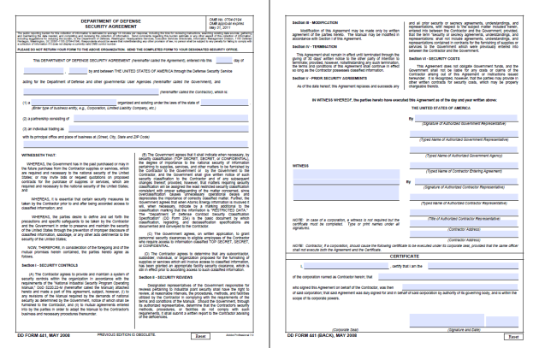
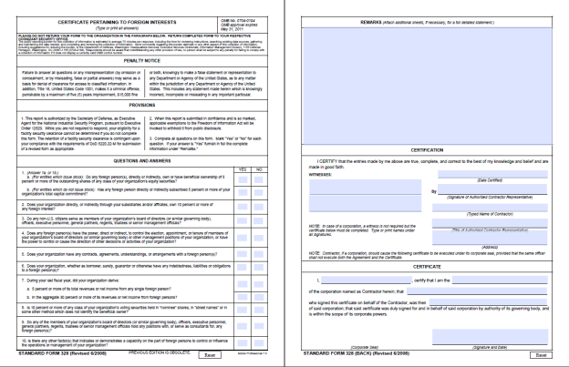
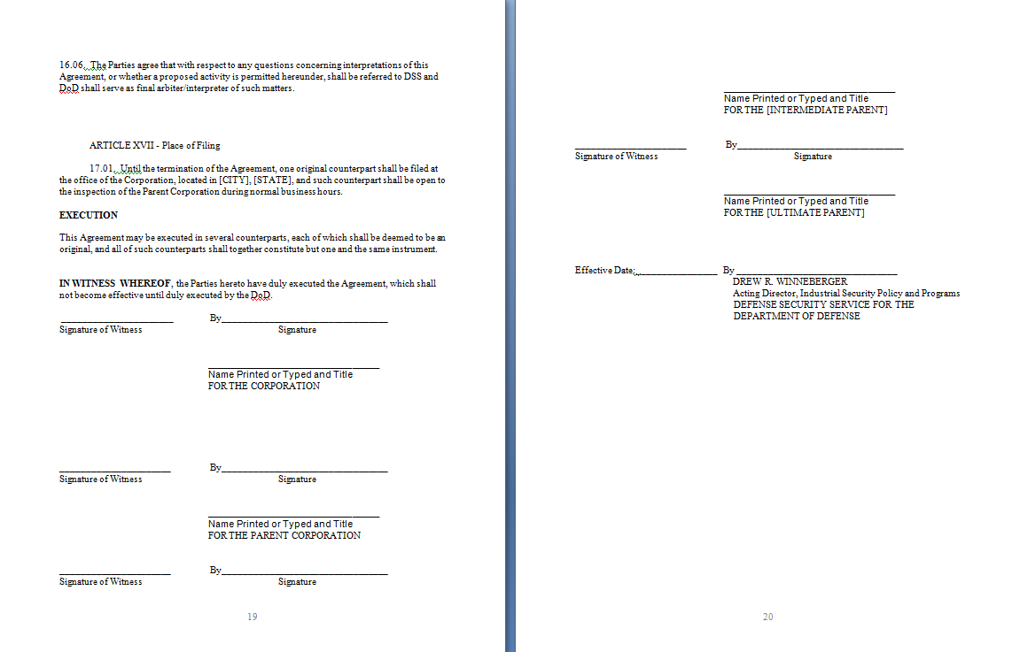
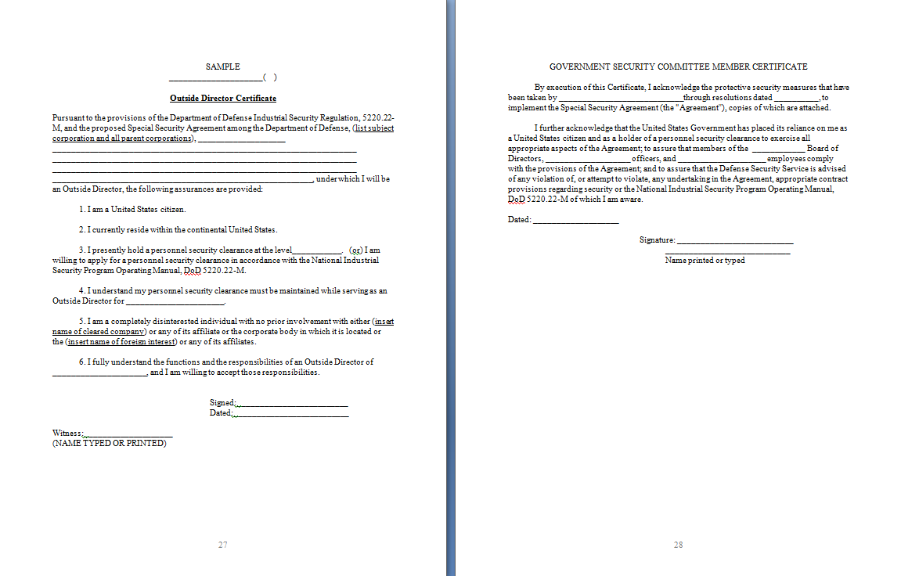
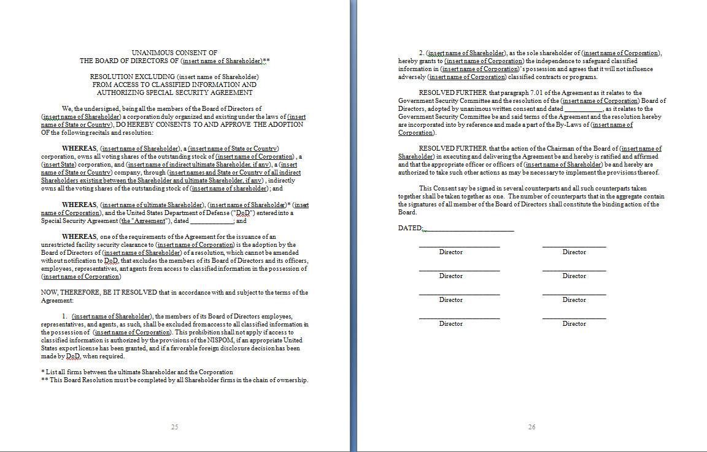
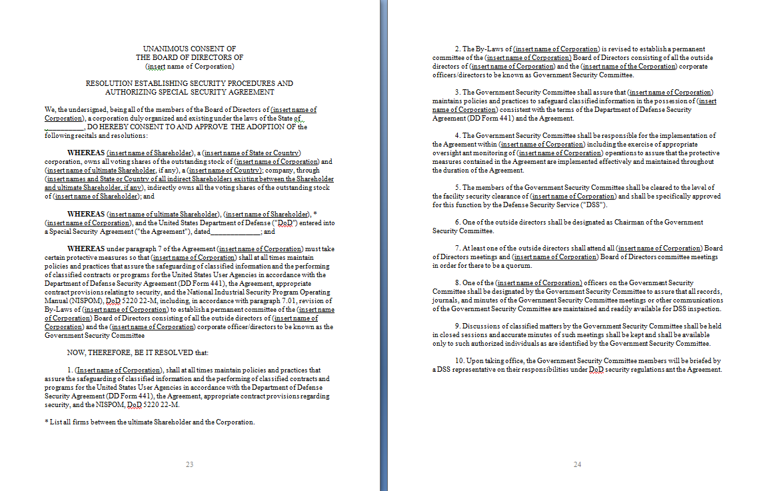
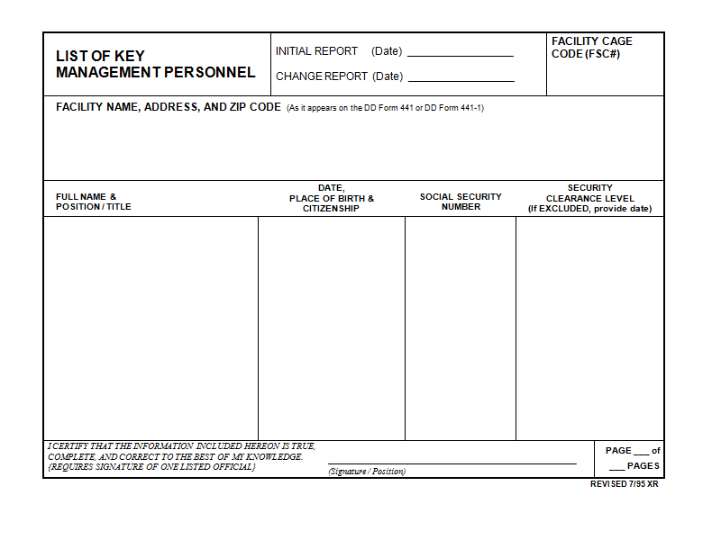
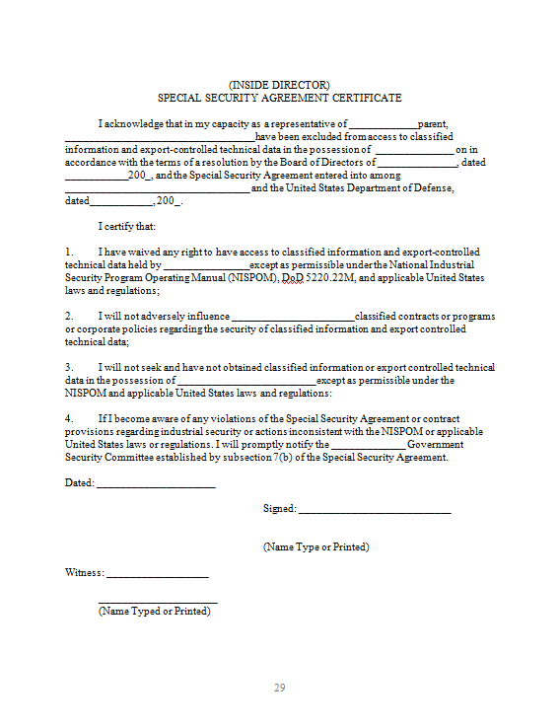
SSA to Mitigate FOCI
SF 328 Certificate of
Foreign Ownership
(FOCI)
DD 441 DoD
Security Agreement
Executed
SSA
FOCI MITIGATION
Certificates
Excluding
Parent Company
Company Set-up
(GSC / KMP /
Board of Directors)
FOCI MITIGATION
12

Slide 13
SSA Compliance Measures
Special Security Agreement (SSA)
Firewall
Separation of Companies to mitigate FOCI
GSC & separate Board of Directors
Defense Security Service
National Industrial Security Program (NISP)
NISPOM
Security Standard Practices incorporate NISPOM
Authorized Facility Clearance
Employee Training
Defense Security Service
Government Security Committee
Oversight
Export Compliance Program
ITAR/EAR (Commerce & Foreign Trade “CFR”)
Import / Export Licenses
Technical Assistance Agreements
Memorandums of Understanding
US Department of State / US Department of Commerce
Executed
SSA
Technology Control Program (TCP)
Regulates the transmission of technical data to and from US
Dictates when Export Licenses are required
Defense Security Service / US Department of State
Electronic Communication Plan (ECP)
Ensures separate computer network
Controls possible export of data controlled by the
Technology Control Program
Defense Security Service
Companies in the US are required to comply regardless of SSA.

Slide 14
How SSA Plans Tie Together
Export Compliance Program
Agencies (DoS, DoD, US Customs, etc) monitor exports via Regulations.
ITAR, EAR, Export Admin Regulations., Controlled Military Tech agreements, etc.
Methods for obtaining & maintaining export / import licenses
Re-Exports
Record Keeping
Internal Monitoring
Training
Identification, Receipt & tracking of ITAR Controlled Items / Technical Data
Corporate Commitment & Policy (TCP)
Restricted / Prohibited Exports & Transfers
Violation
Penalties
Technology Control Plan
Establishes compliance with the Arms Export Control Act, ITAR, and EAR. Specific policy governing the Export Compliance Program.
Plan for Complying with Export Compliance Program Requirements
Control access for all export controlled data and services
Ensures control of technical data, e.g. drawings, specs, blueprints etc, via visits & communication
SSA
National Industrial Security Program
NISPOM
Specific standards for protection of all information
NISP ensures that cleared U.S. defense industry safeguards classified information in their possession while performing work on contracts, programs, bids or R&D efforts.
Basic Standards for the protection of classified information
DoD Mandated instructions for security compliance
Electronic Communication Plan
Cumulative effect to create the “firewall”
FOCI Mitigator – ensures no undue influence by Foreign Parent / Affiliates
Monitor and control in person or electronic contact between parent / affiliate companies
Comply with export, TCP & Security Plans –
Visit procedures for affiliates w/ FN procedure for non-US Citizens
Includes CUI, CI & Export Controlled data in-person or electronic comm.

Slide 15

Export Compliance Program
Definitive
Policy
Compliance
Program
Guidelines
Record
Keeping
Training
Compliance
Monitoring
Commitment of upper management
Written Procedures
Information Management System
Website
Audits & Remedial Actions for violations
Designated Empowered Official
Internal Controls / Corrective Actions
Footprint
(Repeatable Procedures)
New Hire
Restricted Party Screening & Commercial Entities
Technology Control Plan
Weaved into the “fabric” of the institution – Applicable areas engaged
Data “feeds” from key export areas
Recurring / Remedial
Voluntary Self-disclosure
(VSD)
Workflow
Templates
“connects people and processes through a written set of operating guidelines and specific institutionalized procedures and safeguards that ensure employees know their export control responsibilities, that the right procedures are being followed, and that the right questions are being asked to safeguard against potential export control regulatory violations.” DoC EMCP Manual

Slide 16
Tangible Exports
Any item or communication whether in the US or to a foreign destination is an export.
Burden of proof is
on the contractor
to comply with
export regulations
EAR
(Dual Use)
ITAR
(USML)
CONTROL CATEGORY
PRODUCT
GROUP
USML CATEGORY
LICENSE TYPE
10 Categories
0 = Nuclear materials, facilities and equipment (and miscellaneous items)
1 = Materials, Chemicals, Microorganisms and Toxins
2 = Materials Processing
3 = Electronics
4 = Computers
5 = Telecommunications and Information Security
6 = Sensors and Lasers
7 = Navigation and Avionics
8 = Marine
9 = Propulsion Systems, Space Vehicles, and Related
Equipment
21 USML Categories:
Category 1
Category 2
Category 3
Category 4
Category 5
Category 6
Category 7
Category 8
Category 9
Category 10
Category 11
Category 12
TAA (Technical Assistant Agreements)
MLA (Manufacturing Licensing Agreements
DSP-5 Permanent Export
DSP-61 Temporary Import
DSP-73 Temporary Export
DSP-85 Permanent / Temporary Export of Classified Information
DSP-94 Foreign Military Sales
DSP-5 Foreign National Worker License
5 Product Groups
Systems, Equipment and Components
Test, Inspection and Production Equipment
Material
Software
Technology
License Updated
Shipment Arrives in Foreign Location
US Customs
Inspection
License
Requirement
Ship to Authorized
Export Agent /
Licensed Broker
Record
exemption
License
Exemption
Or
Exception
License
Required
(Re-export)
(USML)
No License
Required
(NLR)
Theater
MERs
Theater
MERs
Obtain License
& Other
Export
Documents
Entity List
Designated Nationals
Blocked persons
Unverified List
Denied Persons
Export
Destination

Slide 17
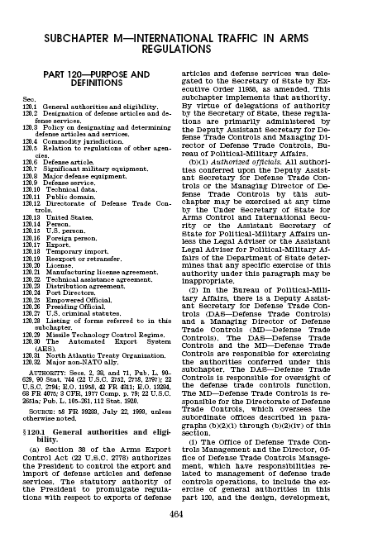
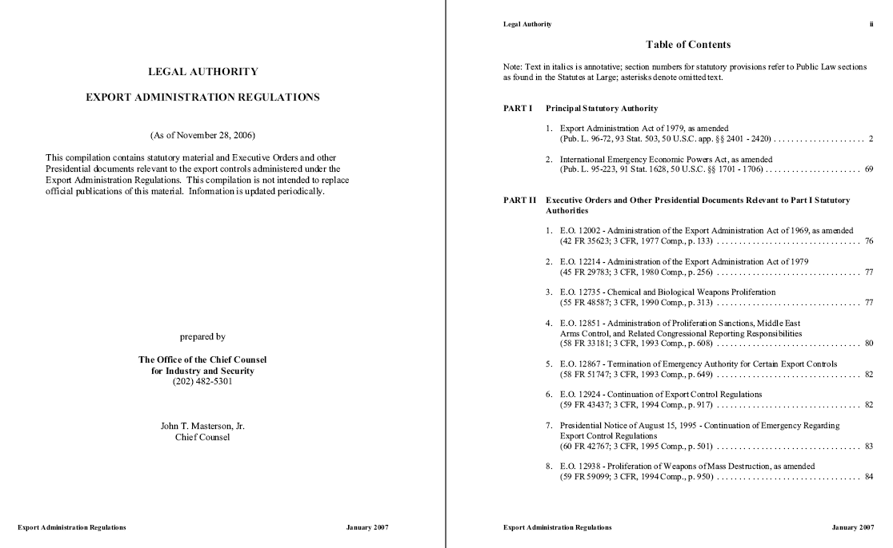
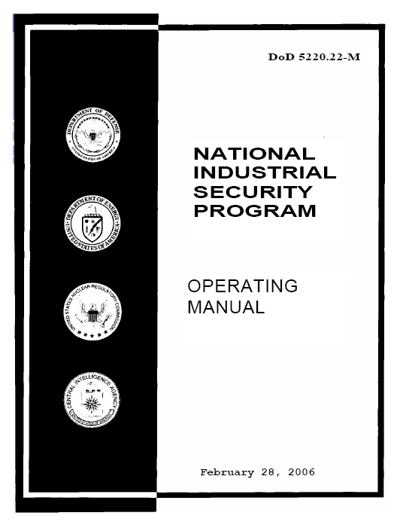
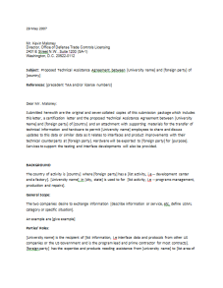
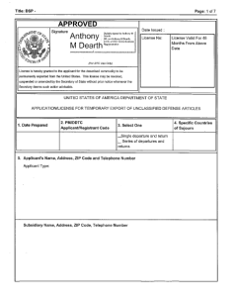
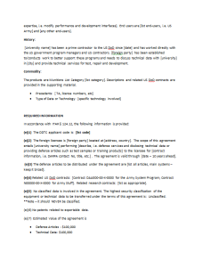
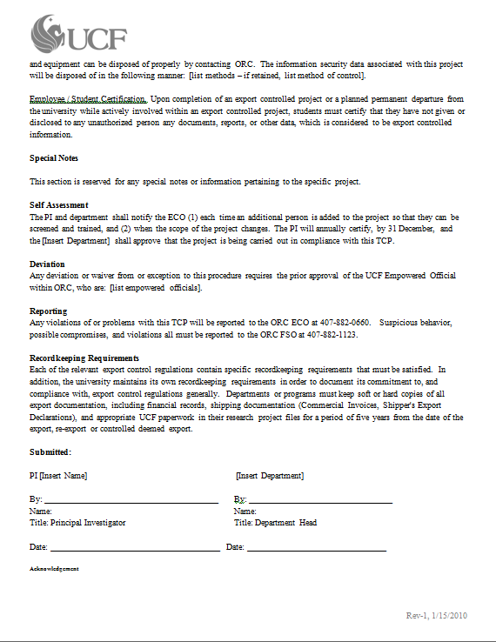
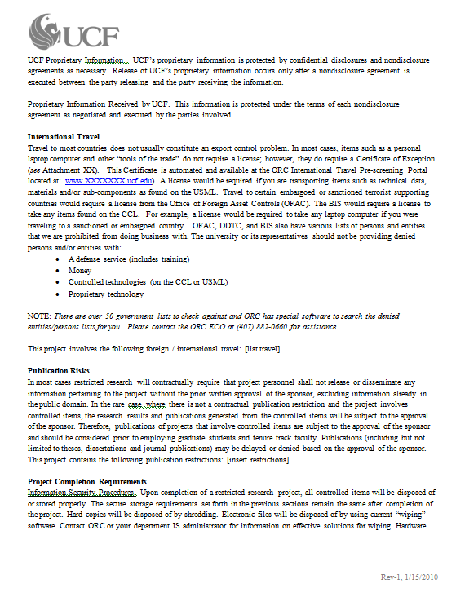
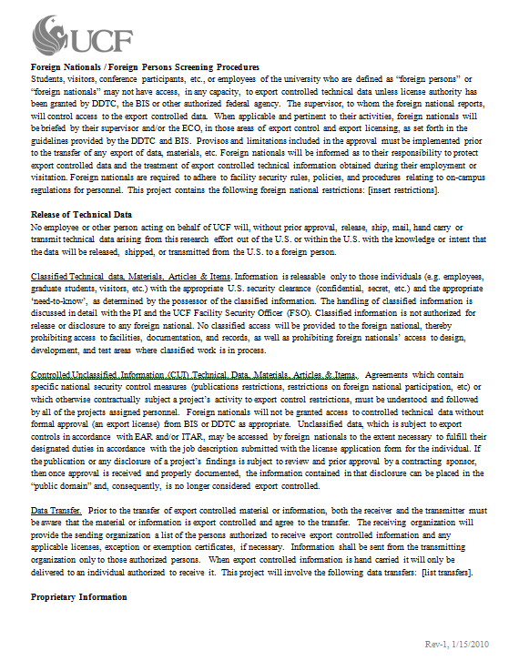
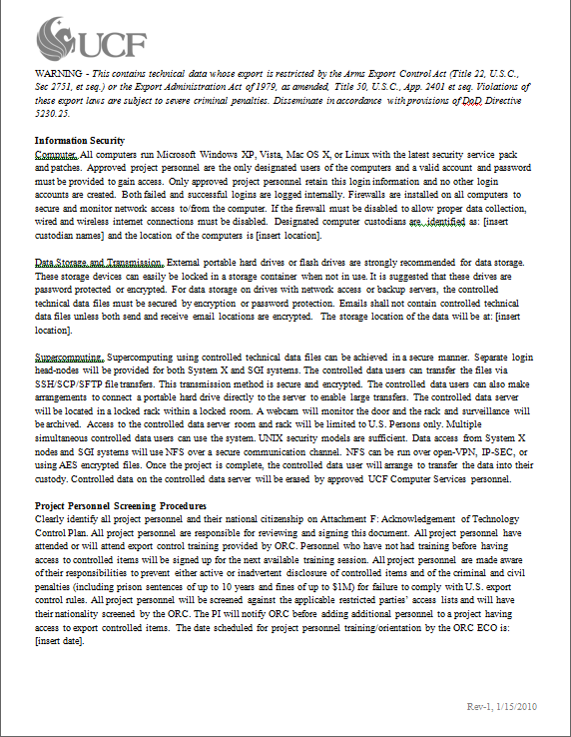
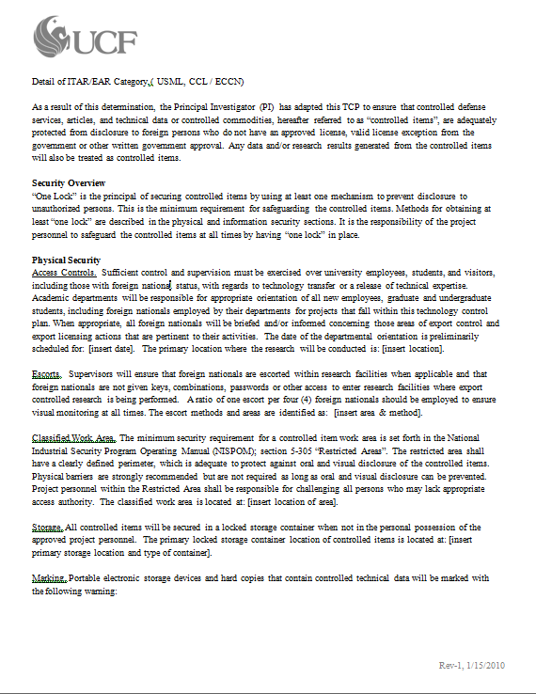
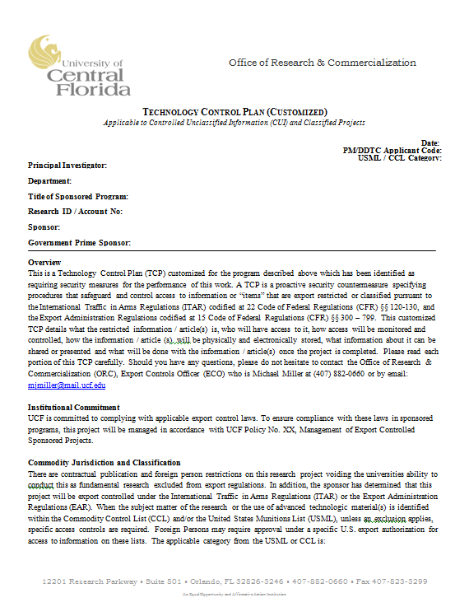
Technology Control Plan
EAR
ITAR
UCF
Technology
Control
Plan
UCF
FN
Employee
TCP
Controlled Technology
NISPOM
US Export Control Laws
License Requirement
TAA
TAA Proviso (additional requirements)
Export Licenses
Example
“Technology” refers to technical data or know-how
TCP
Contract
Program Specific TCP
Contract
Contract
Contract

Slide 18
Operation of the SSA
Board Resolutions & Plans, Policies & Procedures
  Specify how SSA will operate
Numerous Unforeseen Issues:
  Work areas
  Email monitoring & retention
  Phone logs (who is talking to whom and why)
  Visit approvals, logs, & escorts
  Administrative services provided by foreign parent
  Dual-citizen clearances “…guideline requires that any clearance be denied or revoked unless the applicant surrenders the foreign passport ...”
Plans must address each concern
  All staff are responsible for compliance
Annual Review with DSS
18
Notes:
“Consistent application of the guideline requires that any clearance be denied or revoked unless the applicant surrenders the foreign passport or obtains official approval for its use from the appropriate agency of the United States Government.”

Slide 19
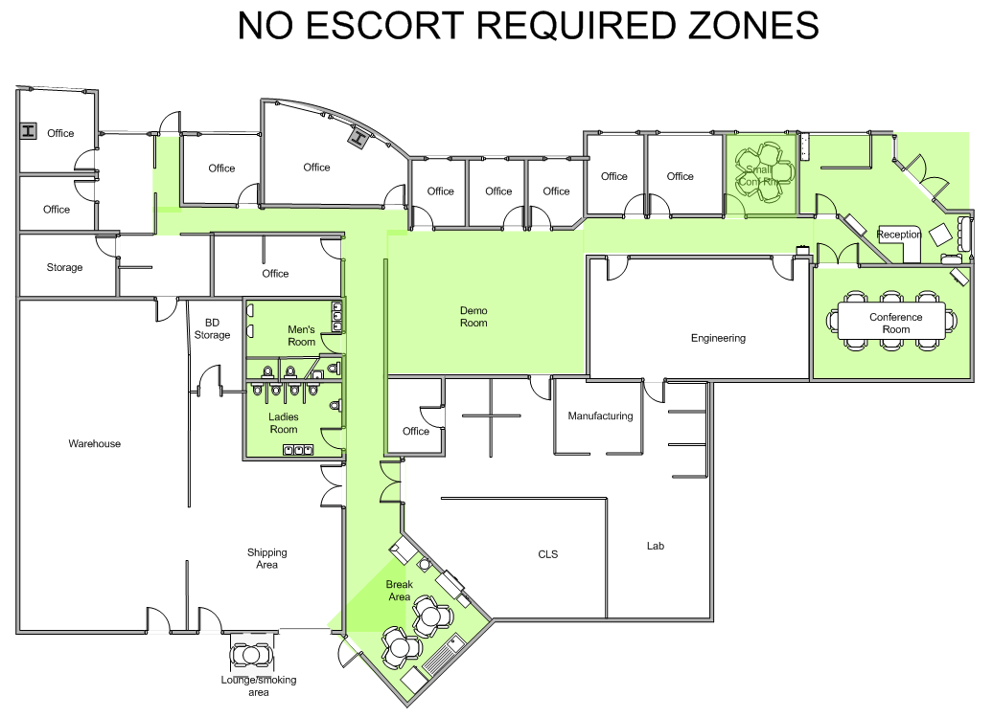
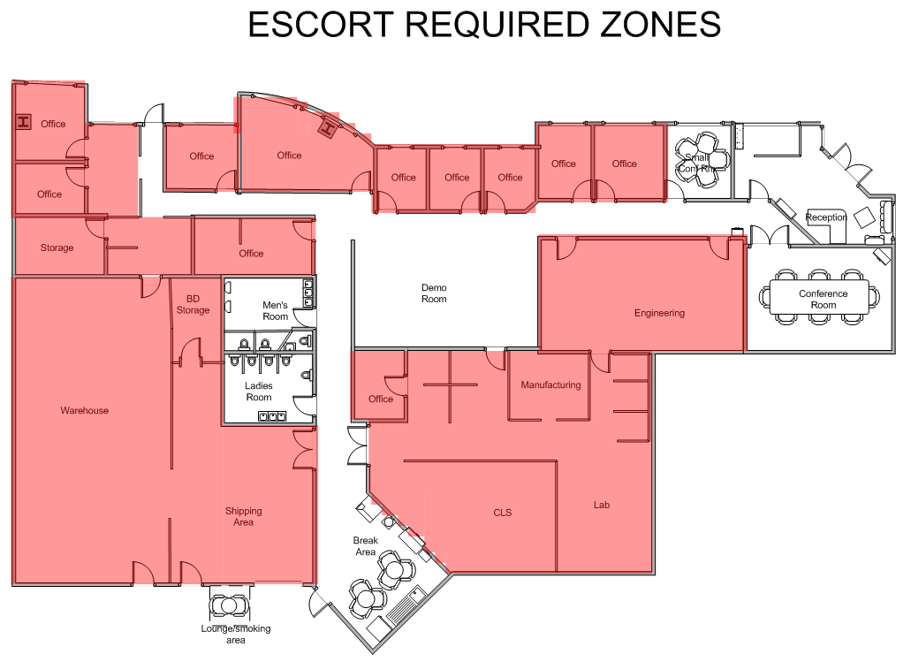
Compartmentalized Work Areas
Each company is unique:
  Common/Unrestricted Area
  Export-Controlled Work Area
  Classified Work Area
  Unlicensed Foreign Nationals must have area to facilitate their work:
    Divide by floors / rooms
    Do not comingle foreign staff with US cleared staff or USML projects
  Clear designation of areas (signs, keypad locks, door badges, etc.)
  Train staff to enforce SPP

Slide 20


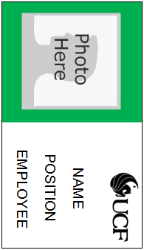
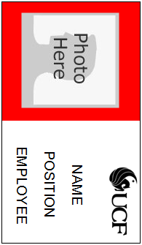
SSA Contacts & Visits
Purpose is to prevent the transfer of US-origin technology to parent
  Email / Telephone
  Face-to-face
Non-Routine Business Visits by Personnel of Foreign Parent (regardless of citizenship)
  Outside Director approval required
Routine Business Visits (those made in connection with regular day-to-day operations that do not involve classified or ITAR information)
  FSO Approval Required
Visit Approval Process:
  Review, Approve/Disapprove, Document, Monitor
  Retain Visit Record Logs
  Different badges for cleared/un-cleared staff
  Different badge for Foreign Nationals
20

Slide 21
Electronic Communications
Managing export-controlled data = cloud of information without knowledge of the location of data. http://www.informationweek.com/news/government/policy/showArticle.jhtml?articleID=228300179&subSection=All+Stories
  Email export is still an export
  IT service provider must also be compliant – where is the data stored?
Electronic Communications Plan (ECP)
  Purpose is to limit & monitor foreign exposure to US origin technology
  Details Network Description
  Data & email monitoring
  Avoid sharing Configuration Management, warehousing, manufacturing databases (or other type of IT)
Administrative Services Agreement (ASA)
  Service agreement to utilize specified parent company services, i.e. HR. Compartmentalization
21

Slide 22
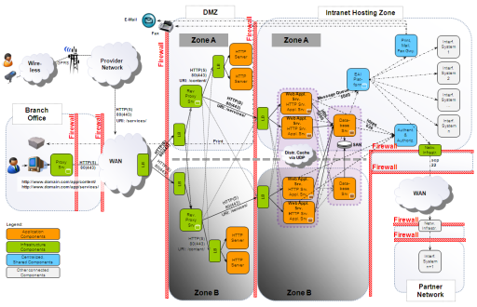
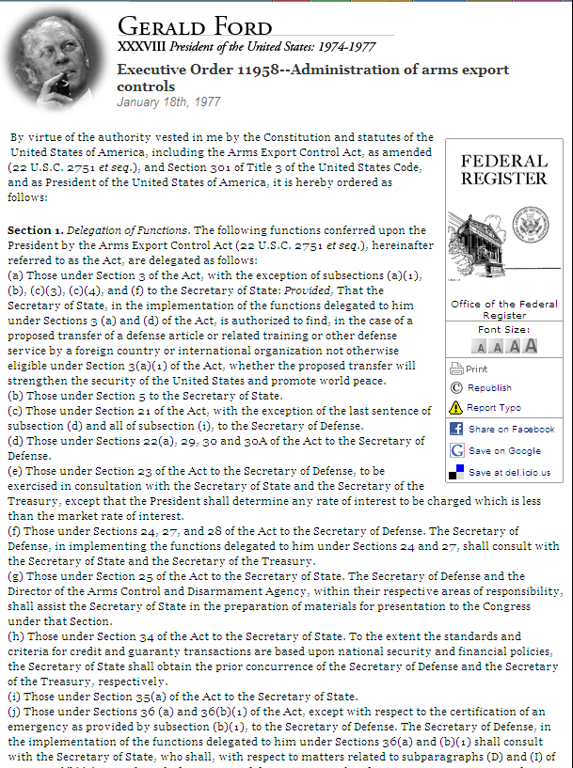
FCL & Classified Projects
UCF
Special
Security
Agreement
UCF
Standard
Practices for
Security
SSA Firewall
NISPOM
UCF
Electronic
Security
Plan
SSA REQUIRED PLANS
DSS Form 381-R
Arms Export Control Act
UCF
Export Control
Plan
IT Firewall
Government requirements: SSA specifies compliance to NISPOM via Company Specific Plans
SSA Required Plans: Mandates firewalls for granting of Secret Facility Clearance.
EAR
ITAR

Slide 23
NISP Compliance
Entry points,
intrusion detection,
activities within facility
Accreditation,
Sanitization & protection
SSA Plans, CUI &
CI Protection
Control
Facility
Train
Employees
Required areas of
NISP Compliance
for Facility Clearance
IT Security
Transfers,
International Visits
& Contractor Operations
DSS Form
381-R
Visit
Procedure
Visits & meetings
(FN & US Citizen)
International
Maintain Clearances
DSS/FBI
Reporting
Safeguard
Information
PCL, maintain FCL, FOCI,
Classification & Marking
Unusual.
Suspicious activity
Licensing, Records & FOCI
Control, Create, store,
disclose, reproduce, transfer
& dispose information

Slide 24
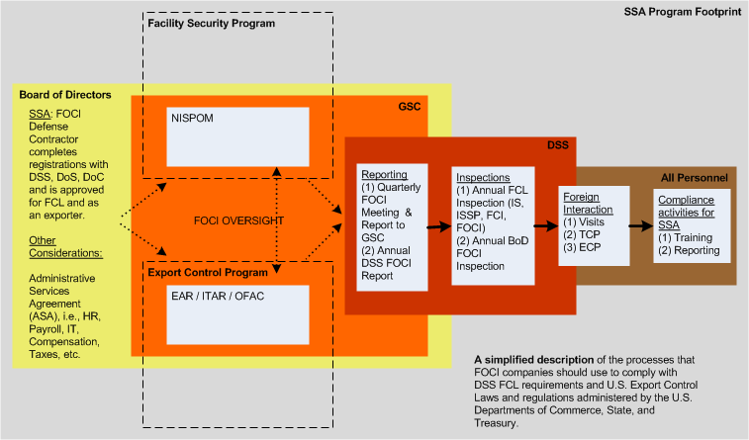
Simplified Description

Slide 25





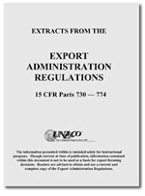


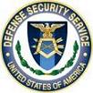







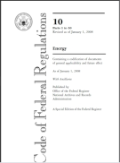
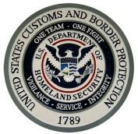
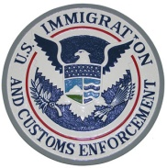



Departments (not exhaustive)
Each agency plays a role in export control
Department Export Arm Authority Regulations Enforcement Investigations
DoC
Census
Export Administration Act of 1969
15 CFR EAR
19 CFR (CBP)
DoJ
BIS
PTO
Office Export Enforcement
DoS
Threat Reduction
?
EECC
FBI
DSS
CIA
Arms Export Control Act of 1976
22 CFR ITAR
ODTC
DoD
DDTC
Operations
DDTC - Enforcement
Licensing
Executive Order 8389
Sanctions
DoT
Trading with Enemy Act
31 CFR
International Emergency Economic Powers Act
Various Statutes
DHS
OFAC
OFAC - Compliance
DoE
Energy Reorganization Act of 1974
10 CFR
CBP
ICE
(Enforcement)
NNSA Export Control
http://www.bis.doc.gov/news/2010/2010eecc_eo.pdf
25

Slide 26
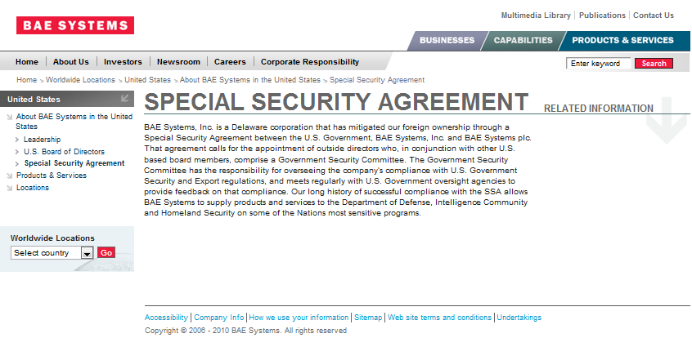
Case Studies
BAE Systems PLC Pleads Guilty and Ordered to Pay $400 Million Criminal Fine
http://www.justice.gov/opa/pr/2010/March/10-crm-209.html

Slide 27

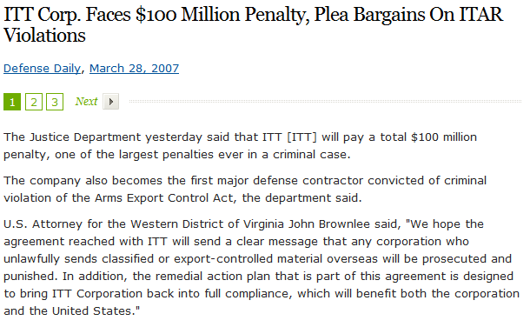
ITT – Night Vision Cat XII

Slide 28
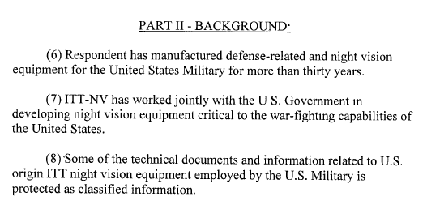
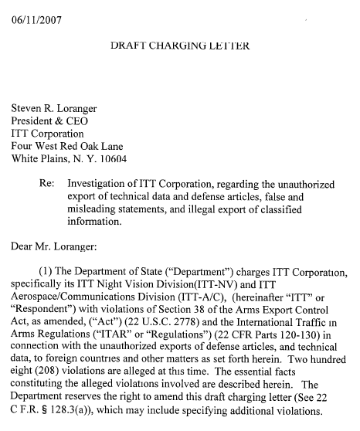
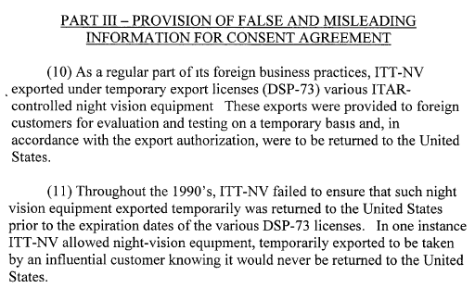
ITT

Slide 29
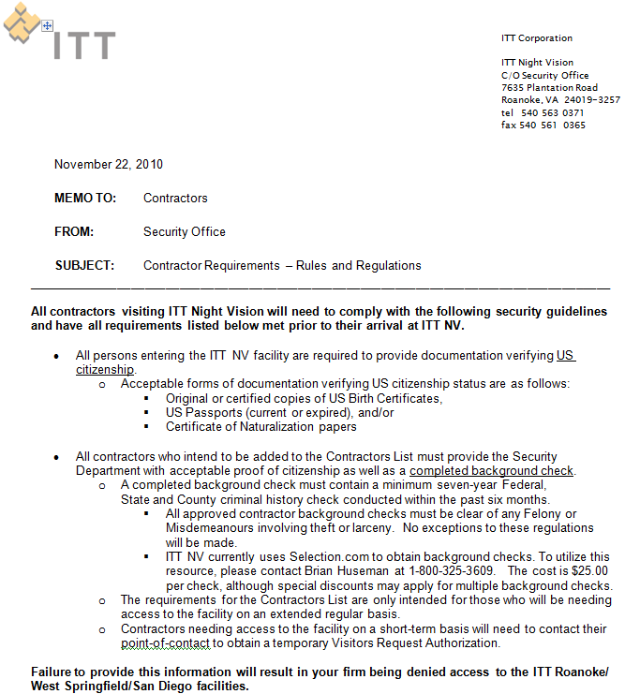
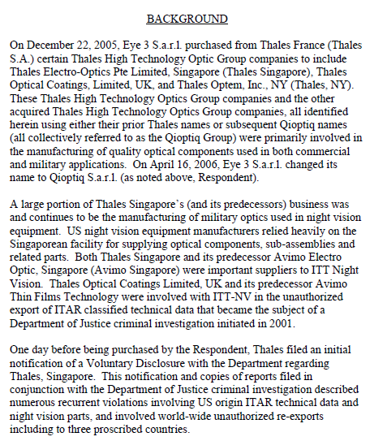
ITT – Thales/Qioptiq Link

Slide 30
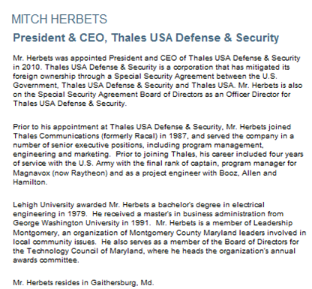
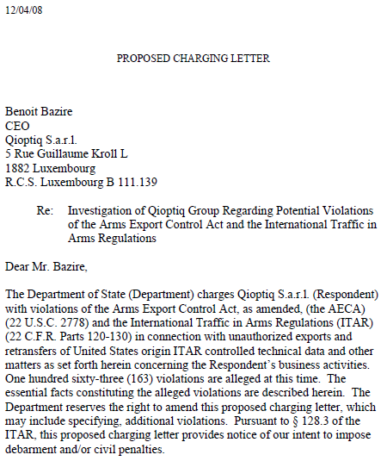
Luxembourg FOCI Company

Slide 31
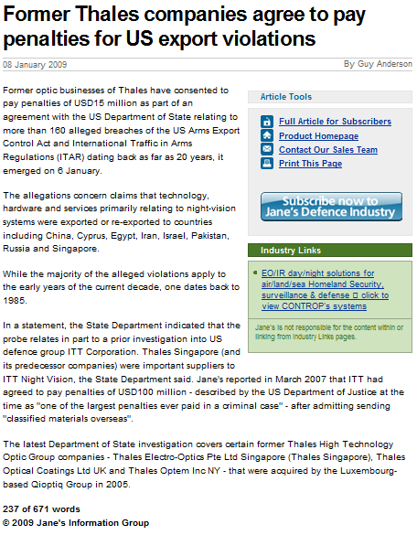
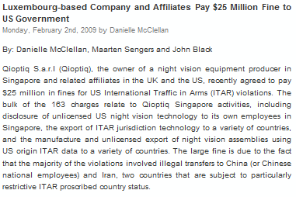

Slide 32
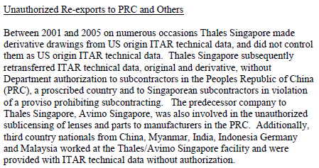
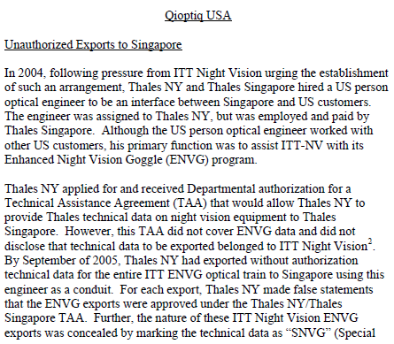
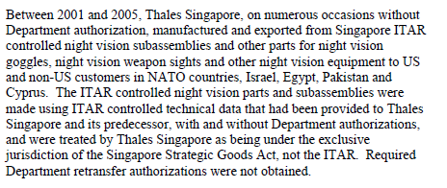
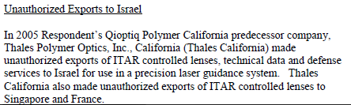

Slide 33
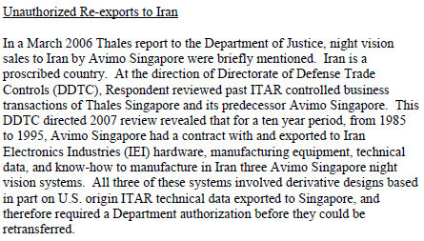
Singapore
Israel
PRC
Myanmar
India
Indonesia
Germany
Malaysia
Egypt
Pakistan
Cyprus
France
Iran
UK
Hungary
Russia
Netherlands
Switzerland
Belgium

Slide 34
FAQ – Local Issues
International Visitors – what to do, TCP, license?
  Defense contractor business
  Foreign visitors on non-DoD commercial business
  Subcontractors
US Citizen requirements for employees?
  Employees
  Interns/Temp Workers
  Cleaning Staff (afterhours?)
Operational work issues:
  Outsourcing IT services/email to foreign-owned company – are you asking?
  Management buyoff

Slide 35
Useful Information
“Partnering for Compliance Conference” 23-25 Feb 2010, at UCF (enrollment limited):
  http://partneringforcompliance.org/index.html
Central Florida SSA Working Group – contact Howard.Rand@saabtraining.com or call 407-380-2425
DSS FOCI Website (includes mitigation templates):
  http://www.dss.mil/isp/foci/foci_info.html
Other Templates (GSC info & guidelines):
  http://nispom.us/modules/wfdownloads/viewcat.php?start=10&cid=15
GAO Report on Oversight of FOCI Influence:
  http://www.gao.gov/products/GAO-05-681

Slide 36
Contact Information
        Mike Miller
        Assistant Director for Export Controls
        Office of Research & Commercialization
        Office of Compliance
        University of Central Florida
        University Tower/Research Park
        12201 Research Parkway, Suite 501
        Orlando, FL 32826
        Phone (407) 882-0660
        Fax: (407) 823-3299
        Email: mjmiller@mail.ucf.edu

